Slide 1
Software Maintenance
Notes:
© SE, Maintenance, Hans van Vliet
Note that the book is misleadingly simple.
Just reading the book is like learning to swim without getting wet.

Slide 2
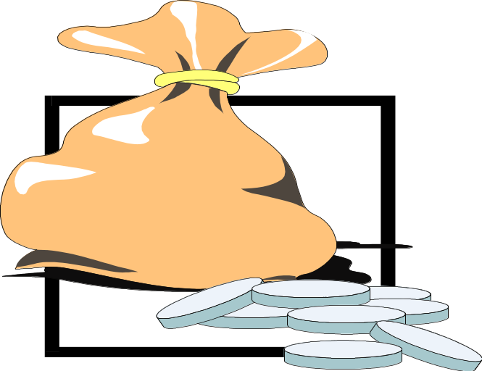
Why does software maintenance cost so much?
SE, Maintenance, Hans van Vliet, ©2008

Slide 3

Software Maintenance, definition
The process of modifying a software system or
component after delivery to correct faults, improve
performance or other attributes, or adapt to a
changed environment
SE, Maintenance, Hans van Vliet, ©2008

Slide 4
Maintenance is thus concerned with:
correcting errors found after the software has been delivered
adapting the software to changing requirements, changing environments, ...
SE, Maintenance, Hans van Vliet, ©2008
Notes:
© SE, Maintenance, Hans van Vliet
- IBM OS 360: 1000 errors per release, and this number did not really go down over time
- quick and dirty bug fixes increase the system’s entropy
- maintenance is usually done under pressure

Slide 5
Key to maintenance is in development
Higher quality ⇒ less (corrective) maintenance
Anticipating changes ⇒ less (adaptive and perfective) maintenance
Better tuning to user needs ⇒ less (perfective) maintenance
Less code ⇒ less maintenance
SE, Maintenance, Hans van Vliet, ©2008

Slide 6
Kinds of maintenance activities
corrective maintenance: correcting errors
adaptive maintenance: adapting to changes in the environment (both hardware and software)
perfective maintenance: adapting to changing user requirements
preventive maintenance: increasing the system’s maintainability
SE, Maintenance, Hans van Vliet, ©2008
Notes:
© SE, Maintenance, Hans van Vliet
- adaptive maintenance does not change the functionality of the system
- people often have trouble distinguishing between adaptive and perfective maintenance
- since most present-day development does not start from scratch, part of maintenance resembles development: both concern the evolution of a system; see also exercise 10 of chapter 14.

Slide 7
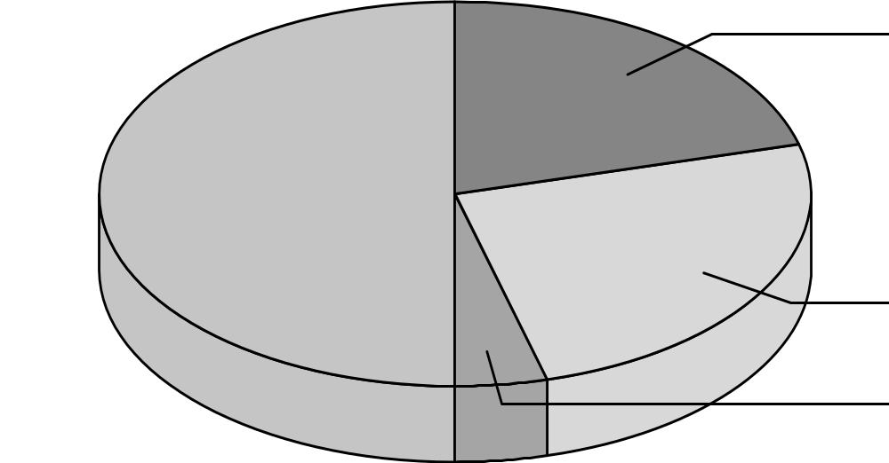
Distribution of maintenance activities
corrective 21%
perfective 50%
adaptive 25%
preventive 4%
SE, Maintenance, Hans van Vliet, ©2008

Slide 8
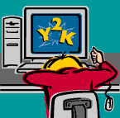
Major causes of maintenance problems
Unstructured code
Insufficient domain knowledge
Insufficient documentation
SE, Maintenance, Hans van Vliet, ©2008

Slide 9
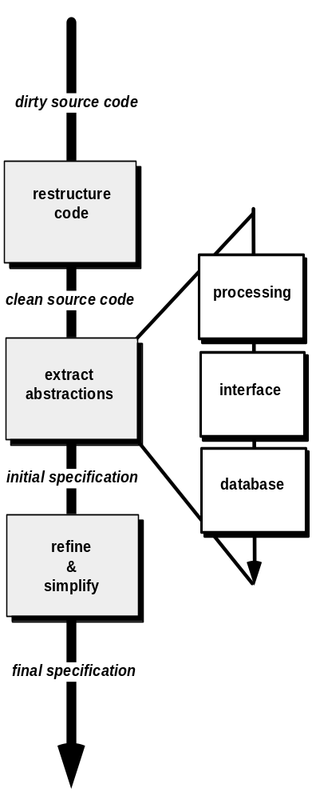
Reverse Engineering

Slide 10
Reverse engineering
Does not involve any adaptation of the system
Akin to reconstruction of a blueprint
SE, Maintenance, Hans van Vliet, ©2008

Slide 11
Software Reengineering
f
o
r
w
a
r
d
i
n
v
e
n
t
o
r
y
e
n
g
i
a
n
a
l
y
s
i
s
n
e
e
r
i
n
g
d
a
t
a
d
o
c
u
m
e
n
t
r
e
s
t
r
u
c
t
u
r
i
n
g
r
e
s
t
r
u
c
t
u
r
i
n
g
r
e
v
e
r
s
e
c
o
d
e
e
n
g
i
n
e
e
r
i
n
g
r
e
s
t
r
u
c
t
u
r
i
n
g
Rabbits Can Dance For Instant Delight

Slide 12
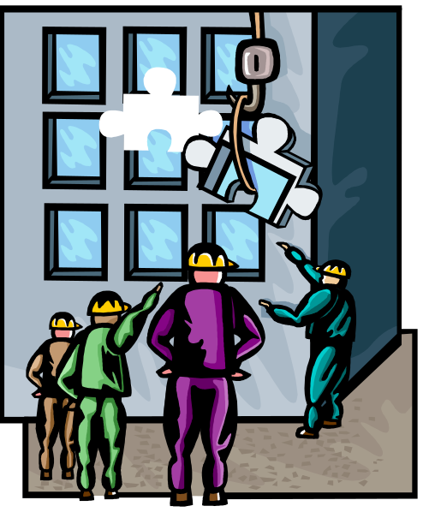
Reengineering (renovation)
Functionality does change
Then reverse engineering step is followed by a forward engineering step in which the changes are made
SE, Maintenance, Hans van Vliet, ©2008

